Slide 1
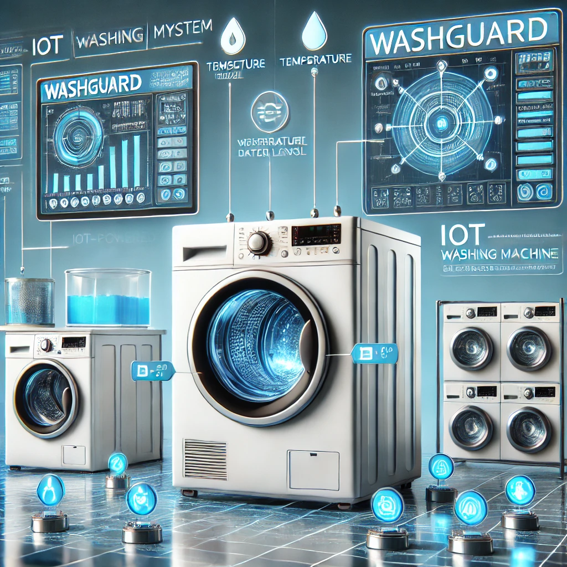
WashGuard Smart Monitoring and Protection for Washing Machines
Presented by: Almog Bacharlia #311434955
Adir Shachri #209135599

Slide 2
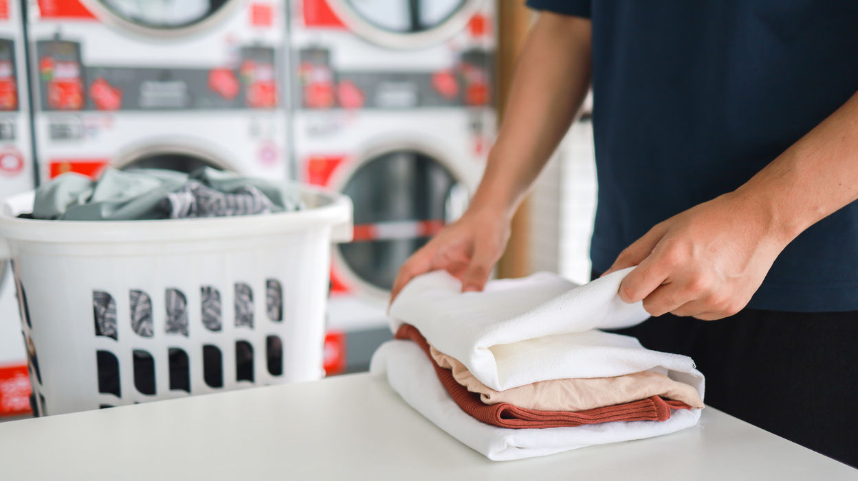
Introduction
Project Goal: Develop an IoT-powered washing machine monitor system to optimize laundry care and detect malfunctions.
Problem Statement: Inefficiency in current laundry systems leads to poor washing outcomes, unnecessary energy consumption, and machine wear and tear.

Slide 3
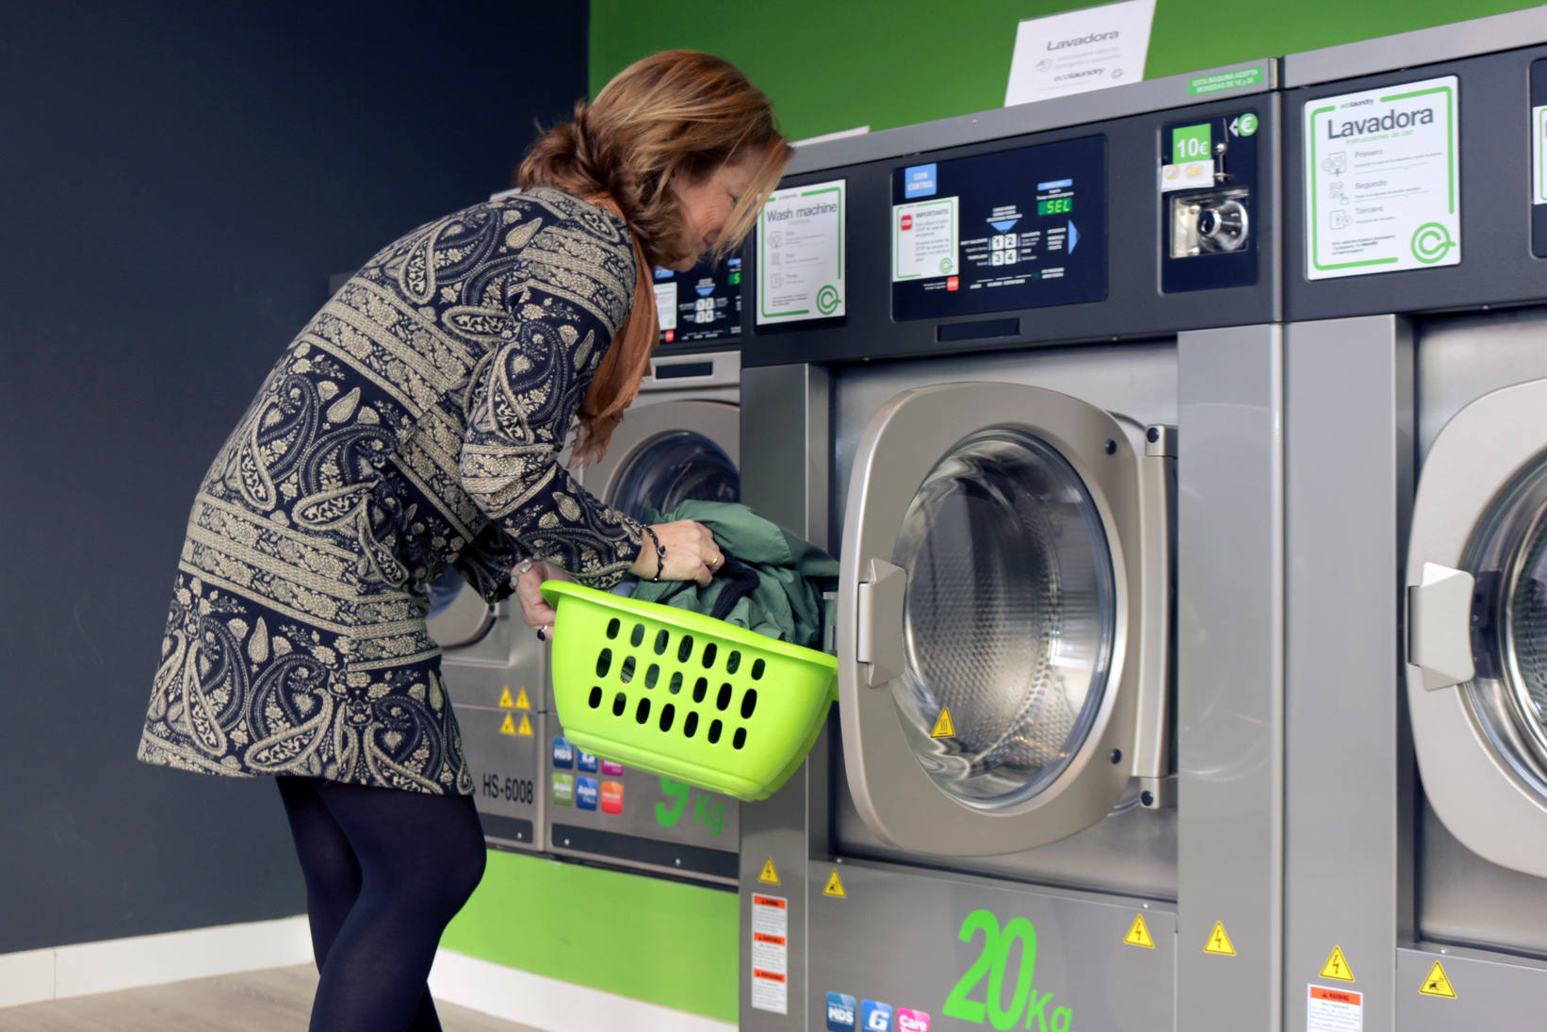
General Description
Main Modules:
Sensors for monitoring
Temperature.
Water level.
Drum rotation.
Electric current.
Workflow:
Data collection, processing, and user alerts via a connected dashboard

Slide 4
Monitoring Washing Machine Condition

Slide 5
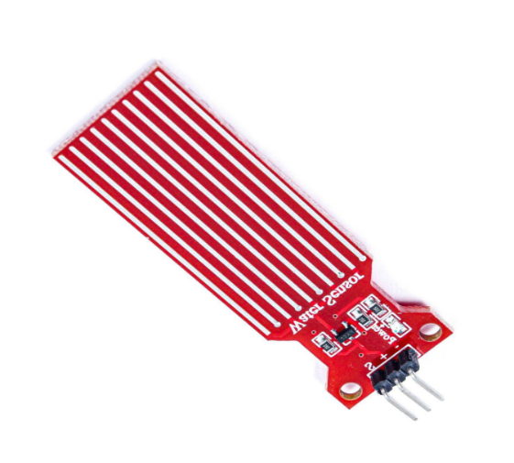
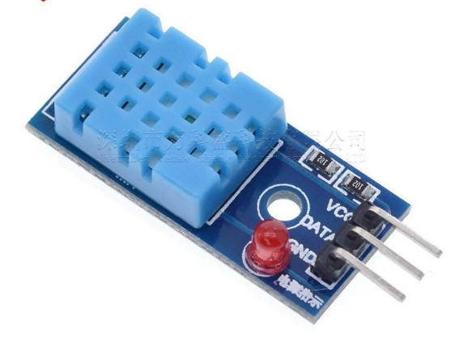
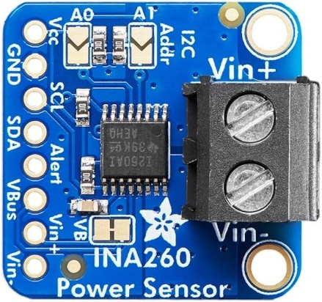
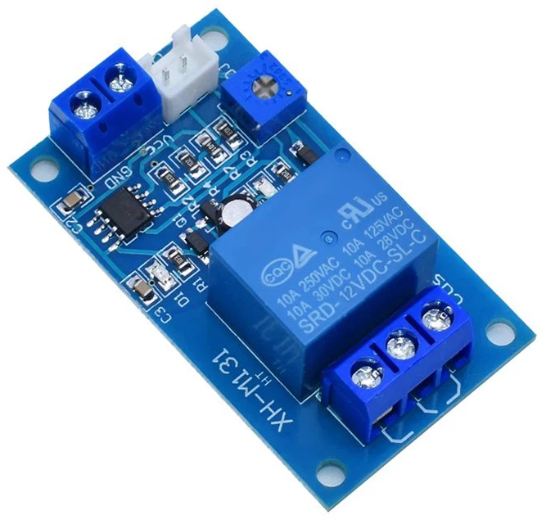
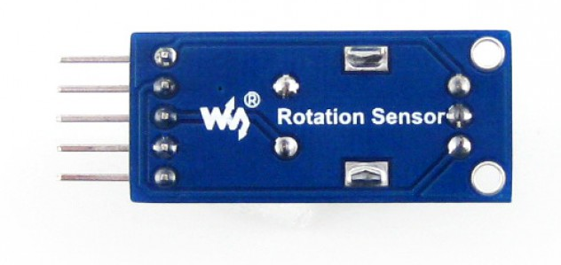
System Modules
Water Level Sensor
Drum Rotation Sensor
Temperature Sensor
Electric Current Sensor
A temperature sensor in an IoT washing machine monitors the heat levels of the water during the wash cycle. It ensures the water temperature matches the user’s selected settings and adjusts the heater if needed. This helps prevent overheating, ensures optimal cleaning, and saves energy.
The water level sensor detects and monitors the amount of water in the washing drum. It ensures the correct water level based on the type and size of the laundry load. This sensor prevents water wastage, ensures efficient washing, and protects the machine from overfilling.
The drum rotation sensor tracks the speed and direction of the washing machine’s drum during operation. It ensures that the drum operates at the correct speed for different wash cycles, detects imbalances, and prevents mechanical failures caused by irregular rotation patterns.
The electric current sensor monitors the power usage of the washing machine. It identifies irregularities in the electrical current, such as surges or drops, and helps optimize energy consumption. It also alerts users to potential electrical faults, enhancing safety and efficiency.
Relay Module
A relay module in an IoT washing machine acts as a switch to control high-power components such as the motor, water valves, or heating elements. It receives commands from the control system and executes actions like starting or stopping the washing machine.

Slide 6
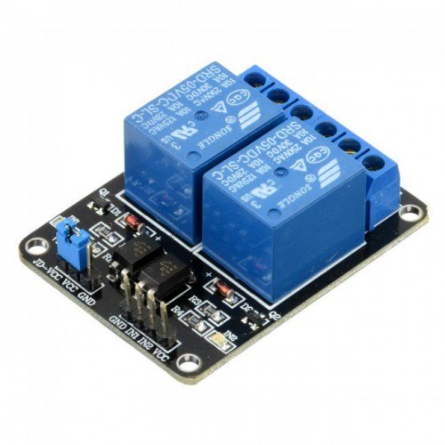



How it Works?
Sensors collect real-time data from the washing machine.
Data is sent to the user interface.
Alerts are triggered for abnormal values.
In auto mode, the system takes corrective actions automatically.
MQTT
Broker
Close/Open commands
Publish
data
Subscribe sensors
data
Publish commands
Machine
status

Slide 7
Design & Development Steps
1. Sensor selection and integration
2. Cloud-based program creation using MQTT.
3.Development of a user application
4. Integration and testing of data transmission.
5. Pilot deployment and performance evaluation

Slide 8
Features and Targets
Features
Real-time monitoring
User alerts for abnormal conditions
Automatically stops machine
Targets
Extend machine lifespan
Improve energy efficiency
Reduce water wastage

Slide 9
Functionality and Flow
Sensor Data Collection The sensors in the washing machine collect data about:
Temperature
Water Level
Drum Rotation
Electric Current
Data Transmission The collected data is transmitted to the MQTT broker.
Abnormal Values Detection If the system detects abnormal values, an alert is sent to the user's dashboard
Automatic Adjustments (Auto Mode)
If in auto mode, the system adjusts settings automatically (e.g., stopping the cycle in case of overheating).
User Interaction
Users can monitor the data and control the washing machine through the application.
Users can switch between manual and auto modes to adjust the machine's behavior.

Slide 10
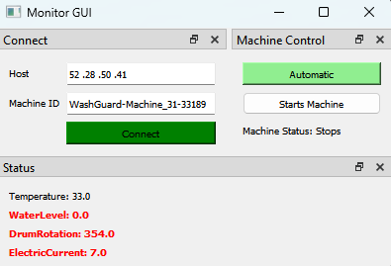
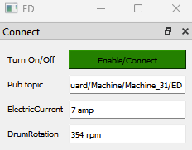
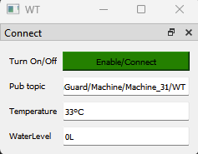
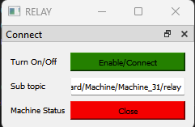
main modules
Mode control
Auto/Manual
Connection
Open/close
button
Current values
Current status

Slide 11
Summary
IoT-based smart monitoring for washing machines.
Conclusions
WashGuard offers an innovative solution for managing washing machines, optimizing the washing process, and ensuring long-term machine durability.
Enhanced machine efficiency and user experience.
IoT Use: MQTT protocol for real-time monitoring and control.

Slide 12
Bibliography
- Sensor Technology: https://www.whirlpool.com/blog/washers-and-dryers/how-choose-laundry-cycles.html
https://www.maytag.com/blog/washers-and-dryers/washing-machine-settings.html

Slide 13
Thank You

